Slide 1
PREDICTING MENTAL HEALTH DISORDERS
Group 5

Slide 2
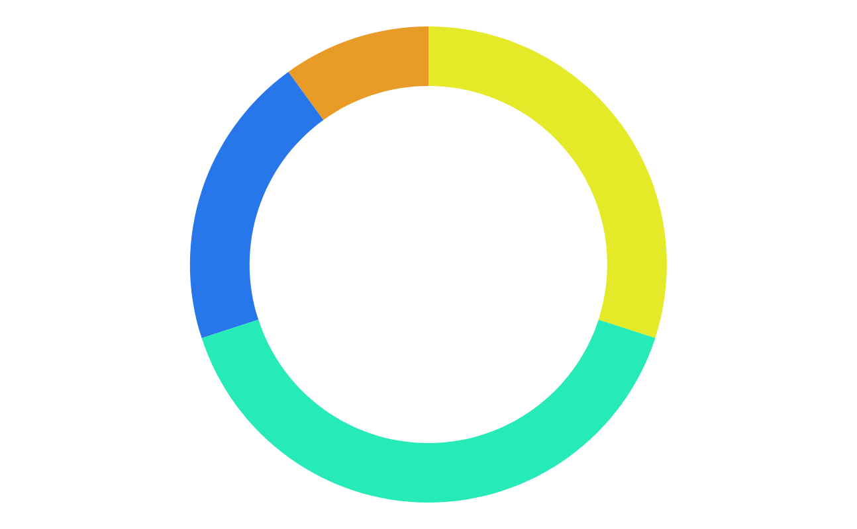
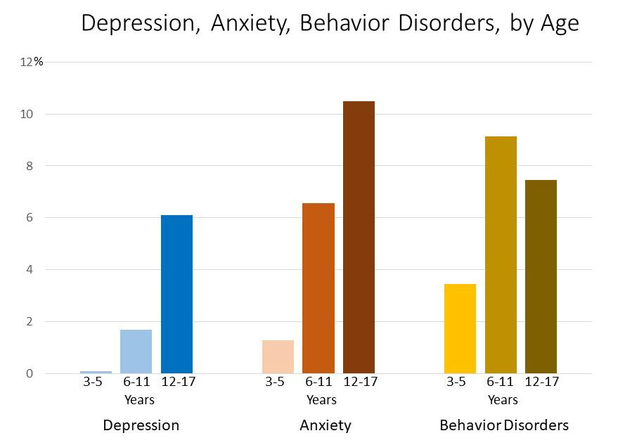
WHAT IS MENTAL HEALTH ?
Mental health includes our emotional, psychological, and social well-being
Our thinking abilities, feelings and actions are affected by our mental health
Research says that half of mental illnesses begin by age 14. So, it is critical to intervene early to minimize its effects on development, education, employment and health of a person
It is important to be aware about mental health and busting the stigma around it
1 in 5 U.S. adults experience mental illness each year
1 in 20 U.S. adults experience serious mental illness each year
1 in 6 U.S. youth aged 6-17 experience a mental health disorder each year
50% of all lifetime mental illness begins by age 14, and 75% by age 24
Suicide is the 2nd leading cause of death among people aged 10-34

Slide 3
PROBLEM STATEMENT
Our project focuses on Stress, anxiety, depression. With appropriate machine learning algorithm we differentiate these three psychological health issues
Dataset was selected from Kaggle - Depression Anxiety Stress Scales Responses
The data was collected through a questionnaire (DASS 42). Out of which 14 questions were allocated to each of the scales of stress, anxiety and depression
Along with answers for each question , dataset also contains each persons other features like age, education, country etc.

Slide 4
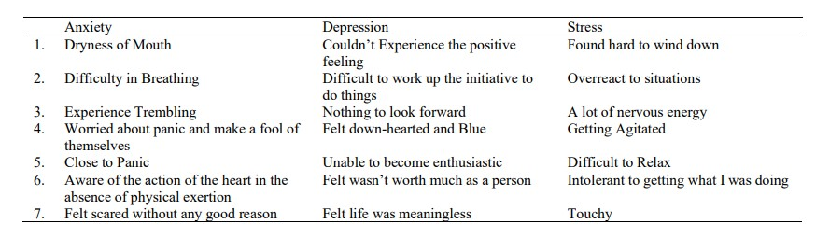
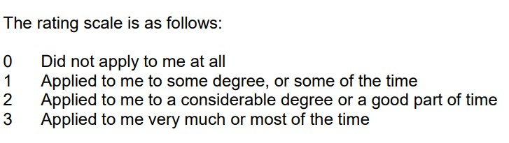
QUESTIONNAIRE FOR STRESS, ANXIETY AND DEPRESSION

Slide 5
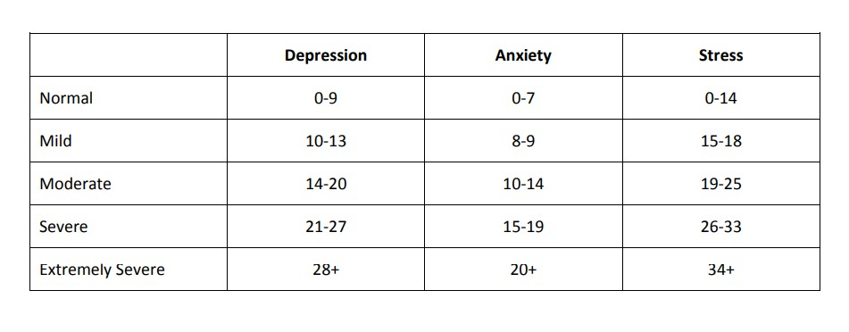
SCALES FOR DEPRESSION, ANXIETY AND STRESS

Slide 6
DATA PREPARATION
This dataset has response values in the range 1 – 4 but ideally DASS(42) considers response values in the range 0 – 3. So, we changed the scales in the dataset from 1 – 4 to 0 – 3
As our focus is on teenagers we considered the age group 13 – 19 and filtered the dataset on this age group
Dataset doesn’t contains outcome columns, so based on the DASS(42) template and scales we created the outcome columns for Stress, Anxiety, Depression by adding the respective response values
As per DASS(42) , response time for each question should not be more. So , in our model we didn’t consider the question with response time more than 25000 milliseconds

Slide 7
FEATURE SELECTION
MODELLING
After analyzing the dataset we found 43 features which were important for the prediction of the outcomes
Where 42 features were the response variables for the DASS(42) questions and other feature was the age column
Every output variable is dependent on 14 features out of the 42 features and the age feature
We used two approaches as in our case, we are predicting multiple outputs – Stress, Anxiety and Depression
In our first approach, we used all the selected 43 features for training the model to predict 3 outputs using MultiOutputRegressor. Here, we are predicting the values which are in the range of the DASS(42) scales which we have mentioned in the previous slide. Then, based on the values predicted, we are classifying them in the given categories

Slide 8
ACCURACY RESULTS
MODEL | ACCURACY
Logistic Regression | 73.09
Random Forest | 29.18
Decision Tree | 19.93
Support Vector Machine | 91.97
Naives Bayes | 16.69

Slide 9
MODELING
ACCURACY RESULT
In our second approach, we classified the 3 outcome variables beforehand into categories based on their scale values and then trained the model
Here, instead of training 1 model for all the 3 outputs, we created 1 model per output variable i.e. 3 models for 3 output variables
For stress model, out of the 43 variables, we trained our model only on 15 features on which the Stress output was dependent. we used a similar approach for training other two models too
MODEL | STRESS | DEPRESSION | ANXIETY
Logistic Regression | 93.8 | 93.71 | 93.96
Random Forest | 90 | 93.38 | 87.81
Decision Tree | 73.52 | 85.822 | 75.62
Support Vector Machine | 93.432 | 92.212 | 93.3
Naives Bayes | 89.54 | 93.34 | 94.33

Slide 10
ISSUES FACED
The dataset on Kaggle did not have the outcome columns. So, by understanding the DASS(42) questionnaire, template and scales, we generated the three outcome columns for Depression, Anxiety and Stress
In the traditional machine learning approaches, we usually have only one outcome column but here, we had to predict 3. So, we figured out 2 approaches to solve this problem: one using MultioutputRegressor and the other, training 3 different models for the 3 outputs

Slide 11
FUTURE SCOPE
We can create an application using this model. The user will have to answer all the 42 questions and then, based on that, the mental disorders will be predicted
We have created this model for teenagers but we can also create a similar type of model for adults too
Along with the prediction of the mental disorders, we can also provide the user with some basic solutions for the treatment of the disorders

Slide 12
REFERENCES
Dataset:- https://www.kaggle.com/lucasgreenwell/depression-anxiety-stress-scales-responses?select=codebook.txt
https://www.sciencedirect.com/science/article/pii/S1877050920309091
https://dl.acm.org/doi/fullHtml/10.1145/3308558.3313557
http://www2.psy.unsw.edu.au/dass/

Slide 13
THANK YOU!!!
By : Group 5
1) Aditya Kurdunkar (323032)
2) Amol Mohadikar (323034)
3) Aditya Moon (323036)
4) Harsh More (323037)
5) Shivam Mishra (323067)

